Slide 1


Lonza Info Session
Bend, OR site
Fall 2018 Recrutiing
Kim Shepard, PhD

Slide 2


Introduction, my path to Lonza Bend
Kim Shepard
Born and raised in NJ
Stevens class of 2010: B.E. and M.E. in Chemical Engineering
    Research in Prof Kalyon’s lab
Princeton class of 2015: PhD in Chemical Engineering
    Adviser by Prof. Rodney Priestley
Moved to Bend in 2015 to start my first job with Lonza (then Bend Research)

Slide 3

Who is Lonza Bend? (Formerly Bend Research)
Live and work where others vacation!
We are an industry leading CDMO that provides drug delivery services
Founded in 1975 as Bend Research, acquired in 2014 by Capsugel, then acquired in 2017 by Lonza
Almost 400 employees across 7 state of the art facilities in Bend develop customized solutions to customers’ most challenging drug delivery problems
Part of ~14,000 employee global Lonza network taking drugs from discovery through commercialization
Reputation of scientific and engineering excellence with highly motivated and empowered employees

Slide 4
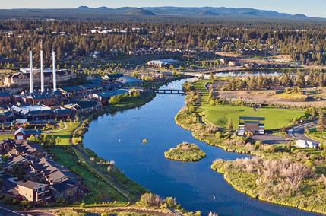
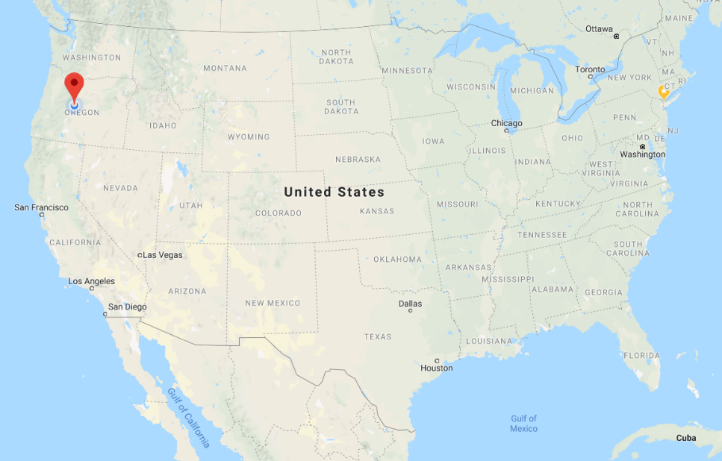
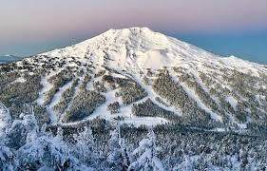
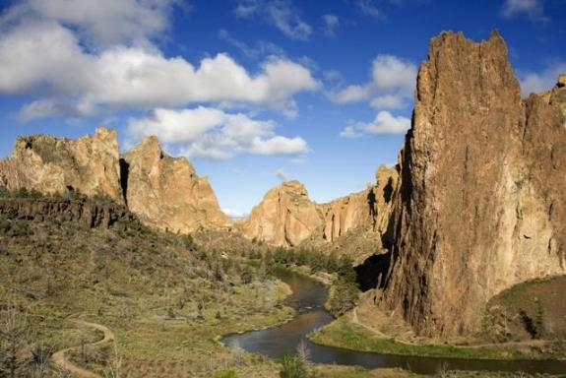
Where is that, exactly?

Slide 5
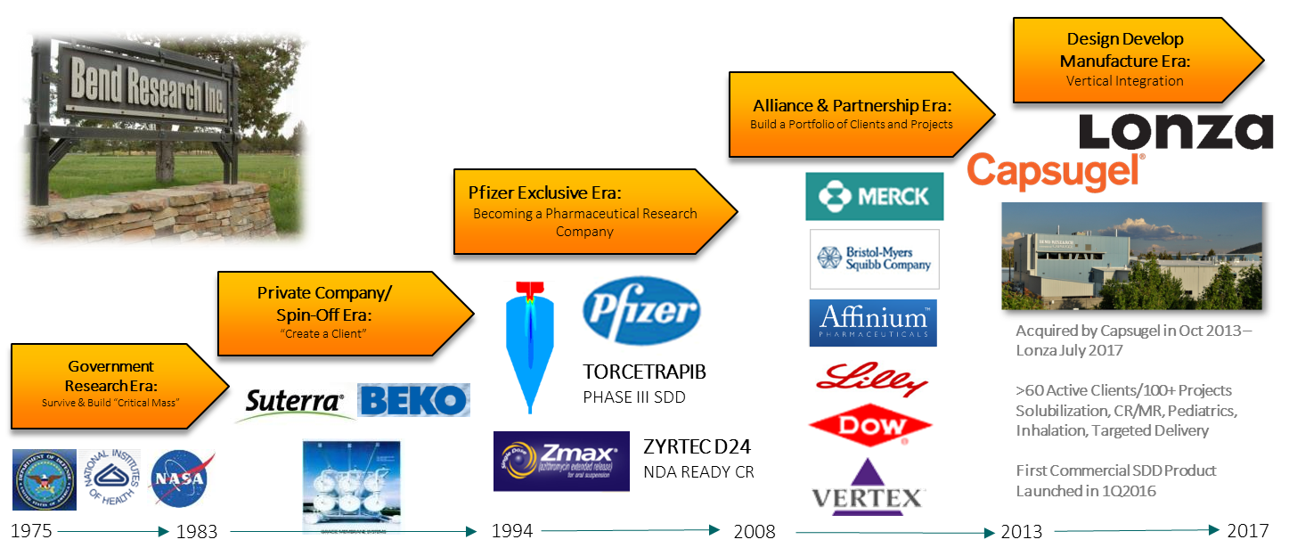
Why is there a pharmaceutical company in Bend, OR?
Bend Research → Lonza

Slide 6
Help make a difference in patients’ lives!
Therapeutic areas we’ve worked in:
Cancer
HIV/AIDS
Progeria
Duchenne's Muscular Dystrophy
Hepatitis C
Rheumatoid Arthritis
Multiple Sclerosis
Radiation protectant
Neonatal formulations
Many drugs with “Orphan” designation

Slide 7
Our site’s business model
We provide pharmaceutical research, development and manufacturing services to clients
Design ------------------------------ Develop -------------------------------- Manufacture
Technology Development
Reduction to Practice
Application to Projects
Commercialization
Product Supply
R&D
Product Development
Manufacturing
Alliance and Project Management
Hundreds of clients worldwide, from 2-person startups to top 10 pharmaceutical companies.
Clients bring us their hardest problems to solve:
Bioavailability enhancement
Modified release
Pediatric formulation
Inhalation products
We cover all phases of pharmaceutical development after discovery
Formulation manufacturing from 100mg to metric tons
Pre-clinical through commercial supplies

Slide 8
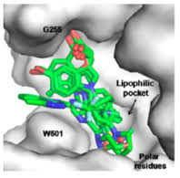
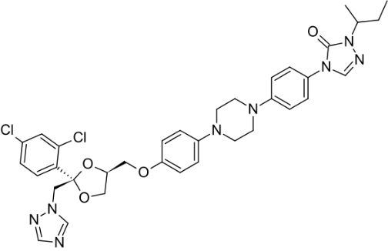
Making Medicines Work: Bioavailability enhancement
Why do we need bioavailability enhancement?
Oral drugs are the most popular dosage form:
Convenient
Painless
Inexpensive
To do its job, drugs must reach “sites of action” many of which are hydrophobic
Up to 70% of new drug candidates are very poorly soluble in water
Itraconazole (Sporanox)
anitfungal agent
High T_{m} (167°C)
High MW (700 g/mol)
Lipophilic (logP 7)
  Octanol/water = 10⁷
Low Solubility (ng/mL)

Slide 9
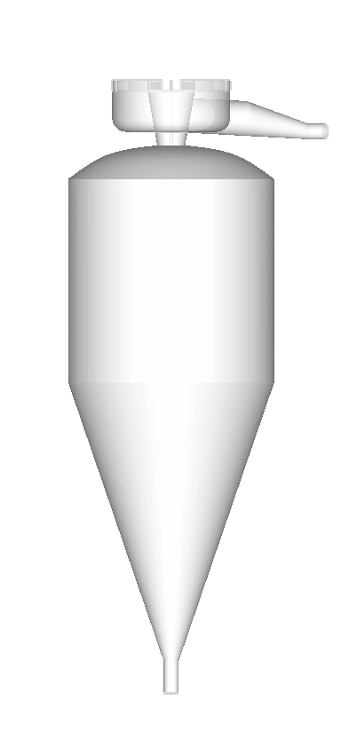
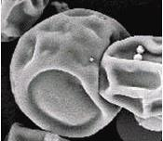
Making Medicines Work: Bioavailability enhancement
Pure drug won’t usually stay amorphous:
Co-dissolve drug and stabilizing bio-compatible polymer in solvent
Atomize the solution and spray dry it to yield a spray dried dispersion
Liquid Feed Soln
Amorphous solubility enhancement
Trapping the drug in a high energy state improves the solubility 2-100x
Atomizer
Hot Drying Gas
Plume
Amorphous Drug
Solubility
Drying Chamber
High Energy Polymorph
Low Energy Polymorph
Free Energy
Spray dried dispersion particles are typically 1-100 microns in size
SDD and Wet Drying Gas

Slide 10
Controlled release of SDDs
SCT: Swellable Core Tablet
Controlled release can reduce dosing frequency, or help reduce side effects in compounds with narrow therapeutic windows

Slide 11
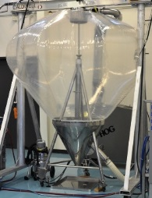
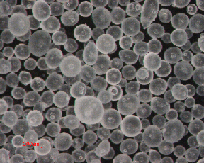
Medicine for all: Pediatric and Geriatric Formulations
Lipid Multiparticulates are easy to swallow, have taste-masking
Babies, the elderly, and disabled patients may benefit from oral drug administration, but cannot take pills or capsules
Lipid multiparticulates are a great alternative:
Good flow properties
Taste-masking so they can be mixed into food
Small enough that they go down smoothly
API and excipients are combined, heated
Melt is pumped onto a rotary atomizer
Droplets cooled to form beads
Beads are collected in bag

Slide 12
Career Opportunities for students and recent grads
Internships for current students
Typically 15-20 interns from around the country every summer
Available during the academic year, too.
Undergraduate and graduate students have done internships
Mostly chemical engineers and chemists
Full-Time opportunities for graduating students
Job postings available online year-round, listings constantly change
(https://www.lonza.com/about-lonza/careers/available-jobs.aspx)
To get in the Bend site recruiting cycle: Interview with me while I’m on campus
Engineer, Scientist are entry level for bachelor’s degree
Sr. Engineer, Sr. Scientist are entry level for PhD

Slide 13
Roles for Engineers and Chemists
Lonza – The Place to Go, Stay and Grow
R&D Chemist or Engineer
Product Development Chemist or Engineer
Internally focused research and development to support new technology innovation and intellectual property deliverables
Primarily work in collaboration with internal project teams
Apply knowledge and capabilities in multi-disciplinary fashion to achieve global R&D deliverables
Externally focused research and development focused on process development studies to evaluate formulation and process interplay to achieve desired target product profile
Work in collaboration with internal and client teams
Process Engineer (Manufacturing)
Technical responsibility over client programs during transition into manufacturing environment
Leverage understanding of technologies and requirements for GMP production
Project Lead (Alliance and Project Management)
Technical responsibility over internal or client programs during feasibility, process development and manufacture
Requires breadth and depth of understanding for key technologies
Analytical Chemist (Quality/In-process control)
Support the quality and manufacture of clinical trial supplies and commercial products

Slide 14
Career tracks at Lonza Bend
Scientist/
Engineer
Sr. Sci/
Sr. Eng.
Principal Sci./ Eng.
Sci. II/ Eng. II
Similar in R&D and Project Development
Line Manager (lead people)
Project Lead/Project Manager (lead client projects)
Business Development
Internships!
Other tracks
B.S. or M.S.
Entry Level
3+ years experience
5+ years experience
10+ years experience
Ph.D.
Entry Level
5+ years experience

Slide 15
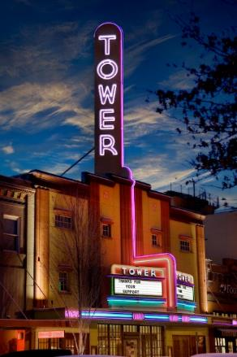


Information about Bend, OR
City of Bend has 85,000 residents. Surrounding area is more like 125,000.
Home to Oregon State University Cascades Campus and Central Oregon Community College
No sales tax! Average rent is $1200 for a 2br condo/house
Redmond airport flies direct to Denver, Salt Lake, Seattle, San Francisco, Los Angeles, Phoenix and Portland
Central is a tourist destination that has lots of restaurants and activities year round:
    28 Craft Breweries (yes, really)
    Over 100 restaurants
    Lots of arts and music festivals
3hr drive or 30 min flight from Portland. 6hr to drive to Seattle or Spokane

Slide 16
Bend is the outdoor adventure capital of the West
Summer Activities:
Our high desert climate means warm, sunny days and cool nights in the summer.
Kayaking, canoeing and paddle boarding on the Deschutes River or in any of the dozens of alpine lakes near town
We’re a world-class fly fishing destination
Thousands of miles of hiking and mountain biking trails. The Pacific Crest Trail runs nearby
Legendary rock climbing at Smith Rock State Park
Active road and trail running scene
Even more: Road cycling, skateboarding, bungee jumping, hang-gliding, mountaineering…
Don’t forget photography!
Winter Activities:
We live on the edge of the Cascade Mountains, so even when there’s no snow in town, the mountains are loaded with it!
Alpine Skiing: Mt. Bachelor is the 5th largest ski resort in the USA, and is a 30-45 min drive into the mountains, depending on where you live.
Nordic skiing and snowshoeing: Groomed and ungroomed trails out of the 7 sno-parks in town. Limitless backcountry!
Hockey and ice skating at our covered ice rink

Slide 17
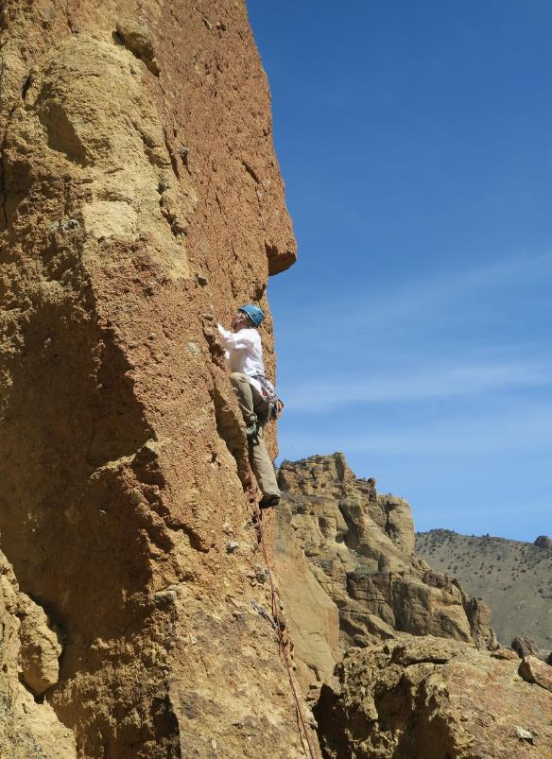

Chemical Engineers in the Wild!

Slide 18
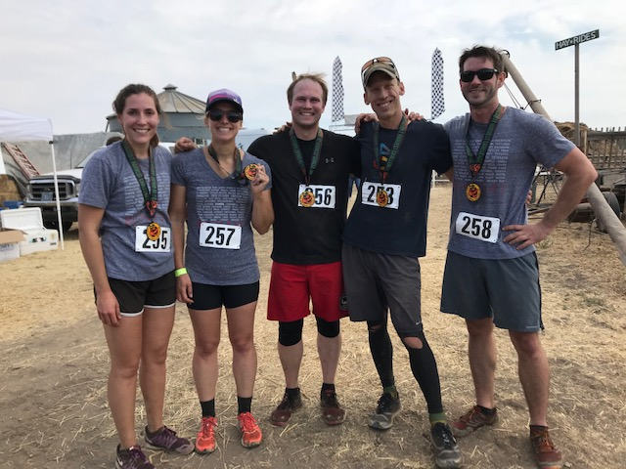
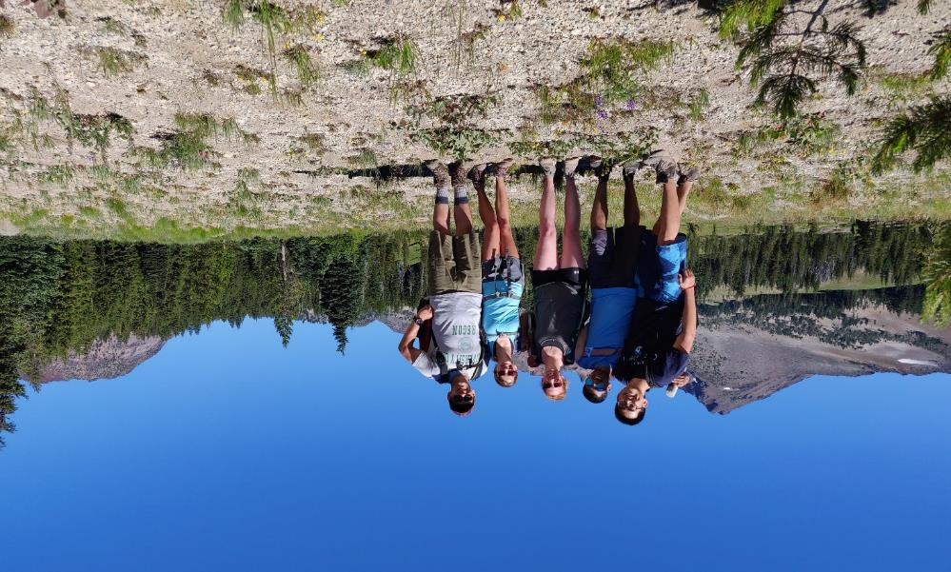
Fun with coworkers!

Slide 19

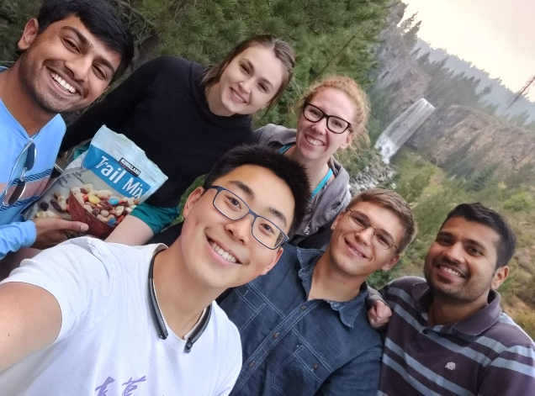
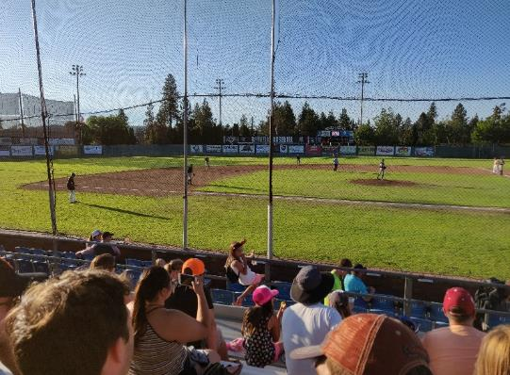

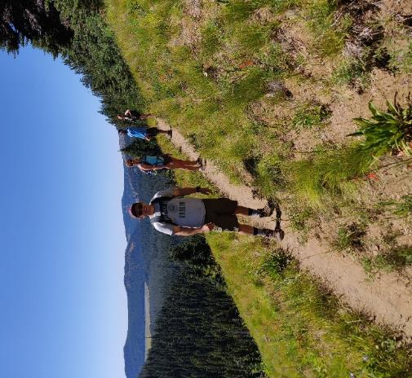
Intern class of Summer ‘18

Slide 20
Thanks!
Questions?

