Slide 1
GBM #12

Slide 2
FAMILY

Slide 3
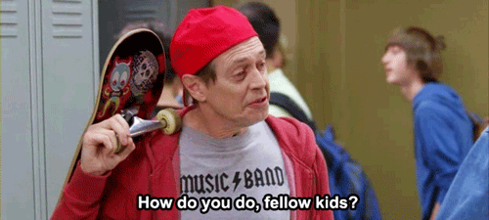
Freshman/Senior Hangout
What u want doe?

Slide 4
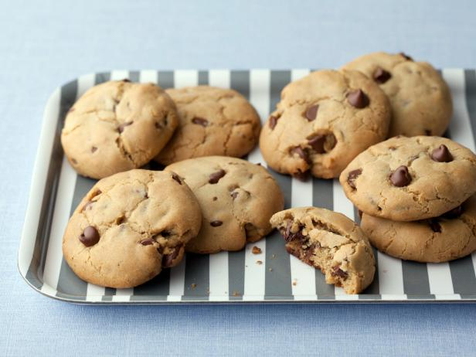
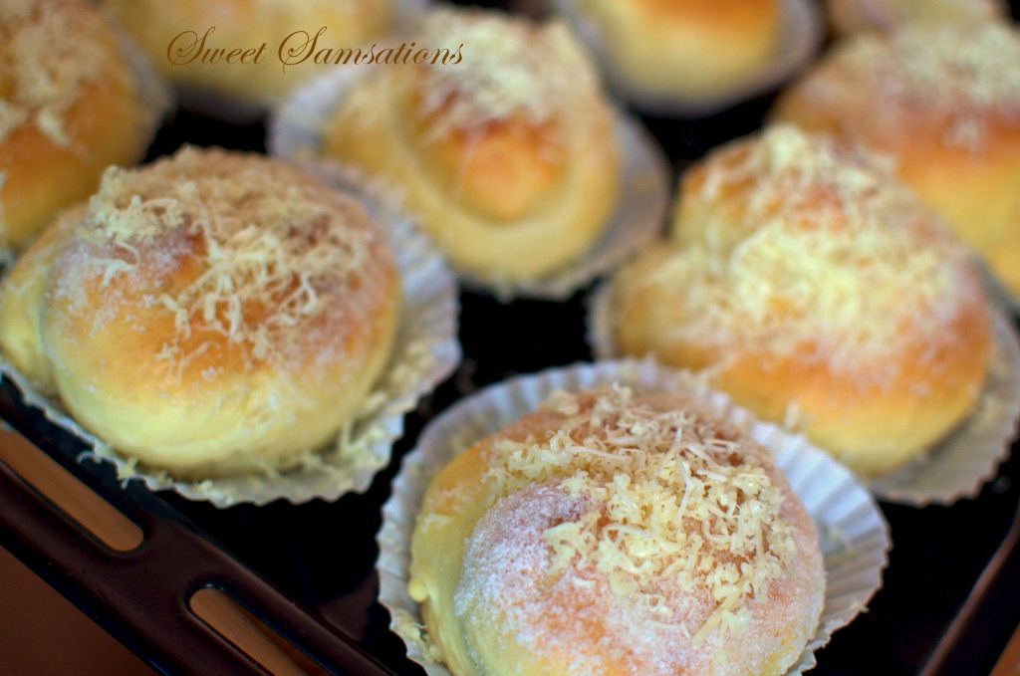
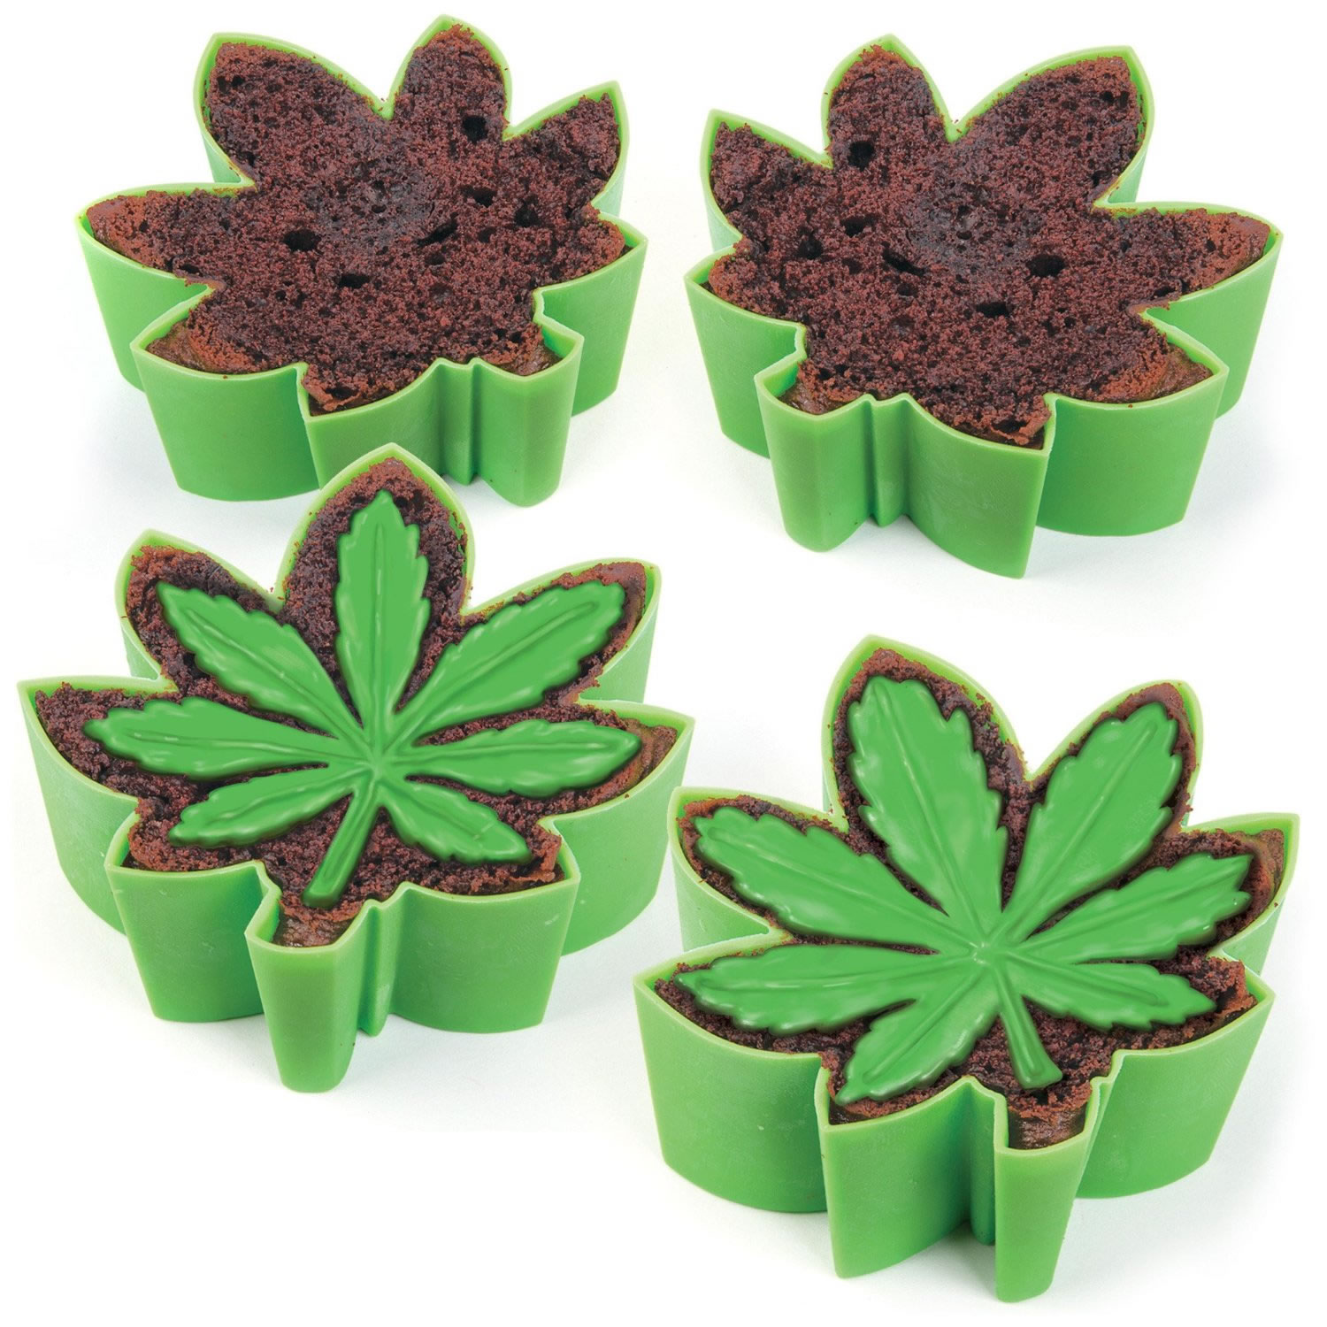
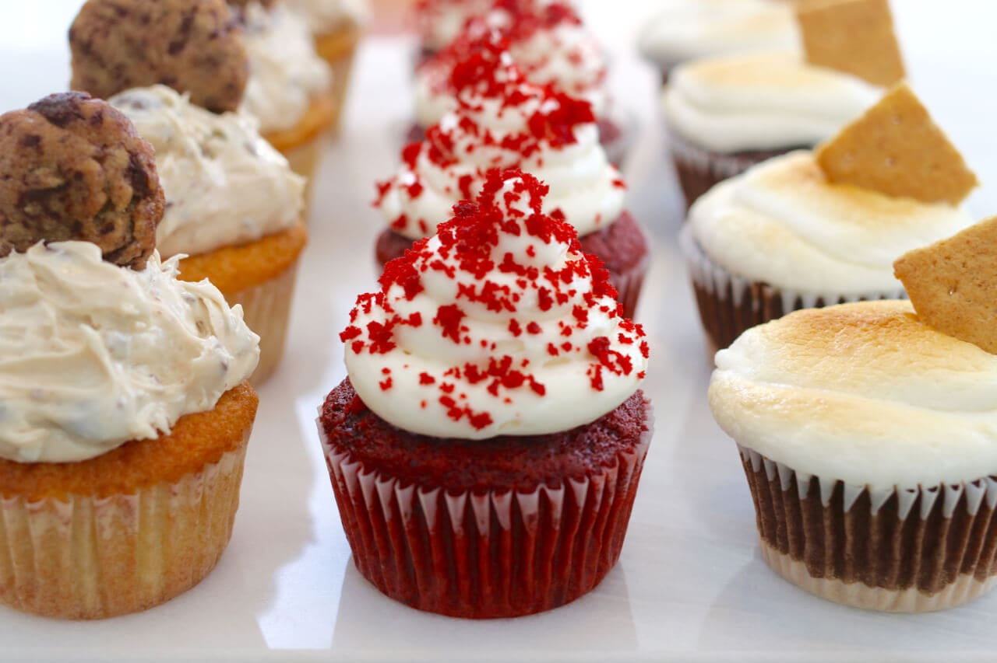
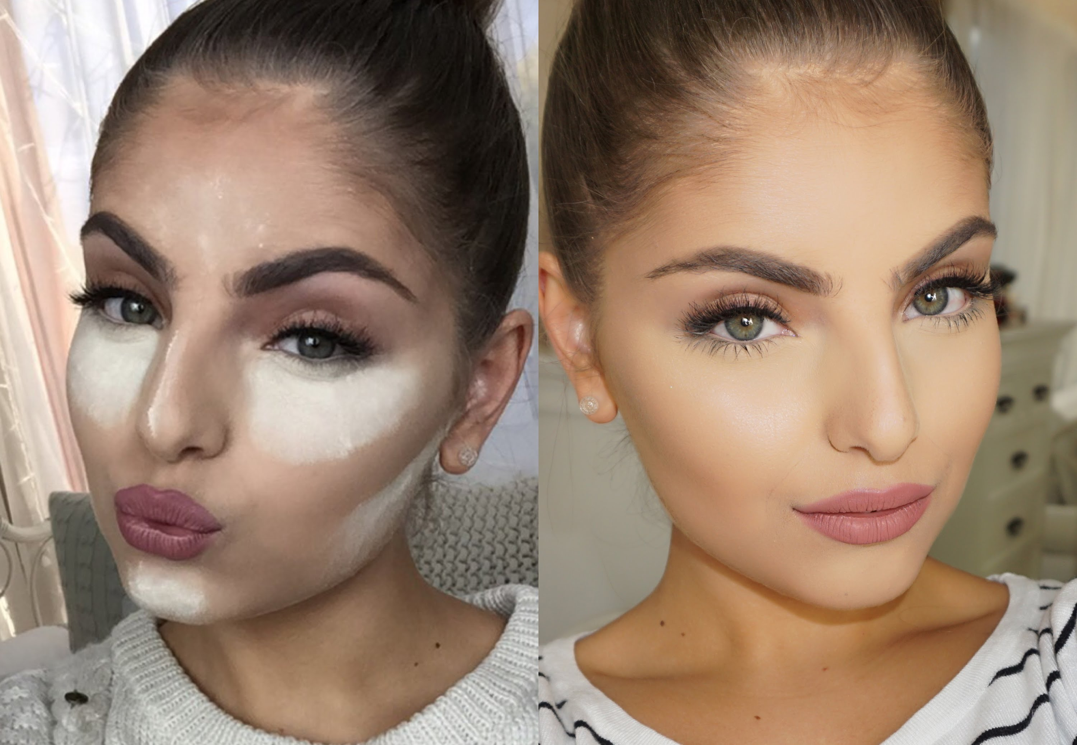

BAKING NIGHT!
WHEN: SUNDAY, MARCH 25
WHERE: TBD

Slide 5



flower festival
Thursday, April 5th
Doors Open @ 8:45pm
yayayaya
Dance, yes
Flower, yes
You there, yes

Slide 6
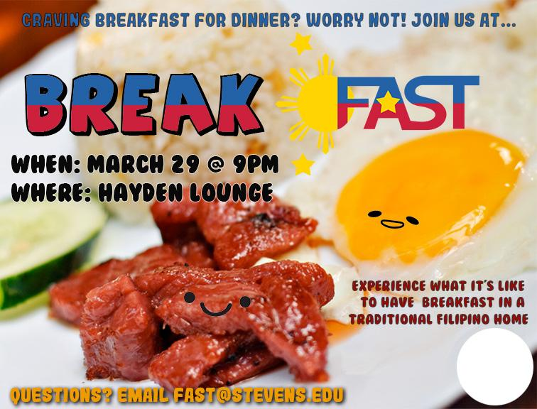


Slide 7
FRIENDS

Slide 8


UNITY
Unity is an event where ethnic clubs perform skits with a common theme
This year’s theme is cultural carbs “Speak My Language”
Interest form:
https://tinyurl.com/UNITYFAST2018
Notes:
“fkin unity joke, i hate” -George

Slide 9
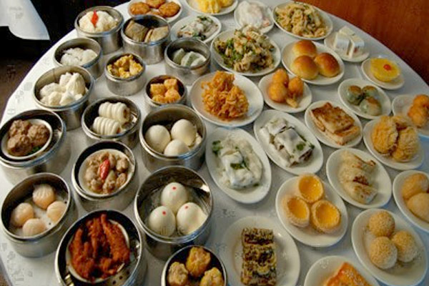
CSA’s Dim Sum Night
Tuesday, March 27
Babbio Atrium - 8:30pm

Slide 10
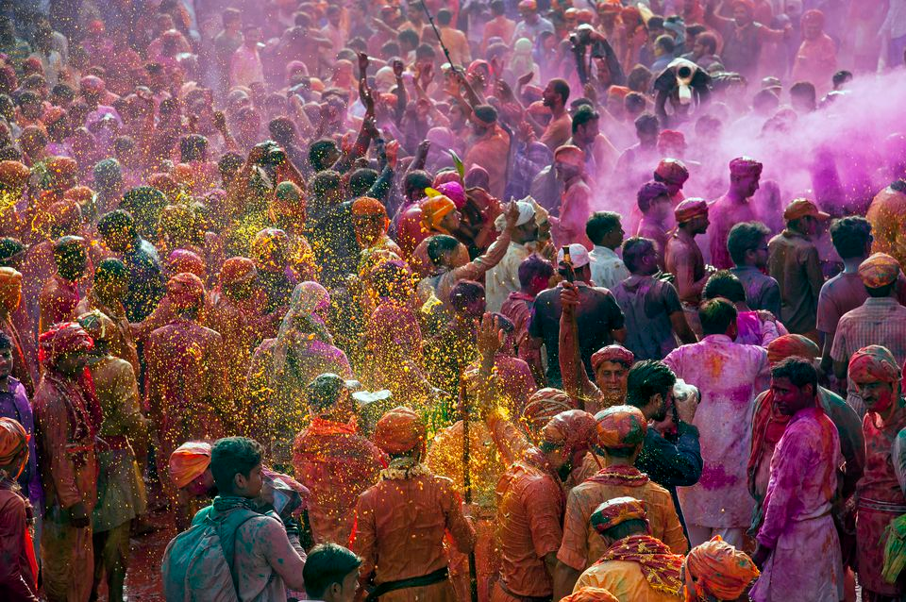
IUA’s Holi
Wednesday, March 28
Palmer Lawn - 2pm

Slide 11
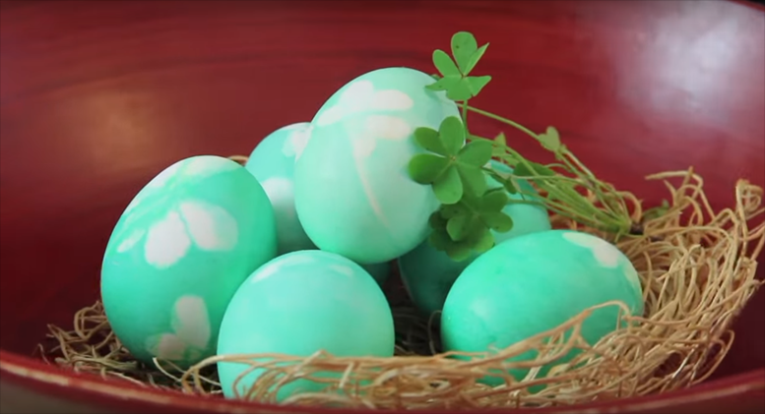
SIA’s Irish Easter
Tuesday, April 3
Hayden Lounge - 9pm

Slide 12

KSA’s Running Man
Wednesday, April 4
Walker Patio - 1pm

Slide 13
FIND & DISTRICT 3

Slide 14

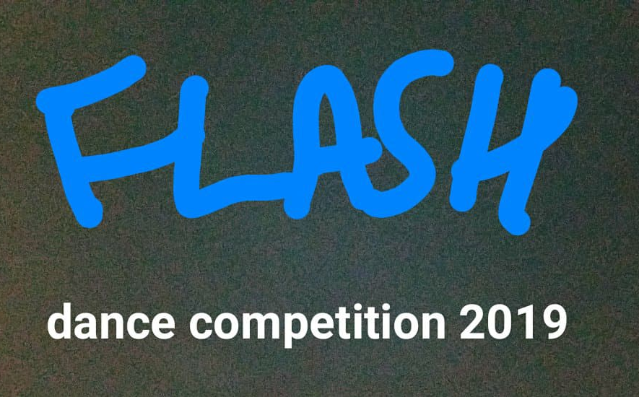

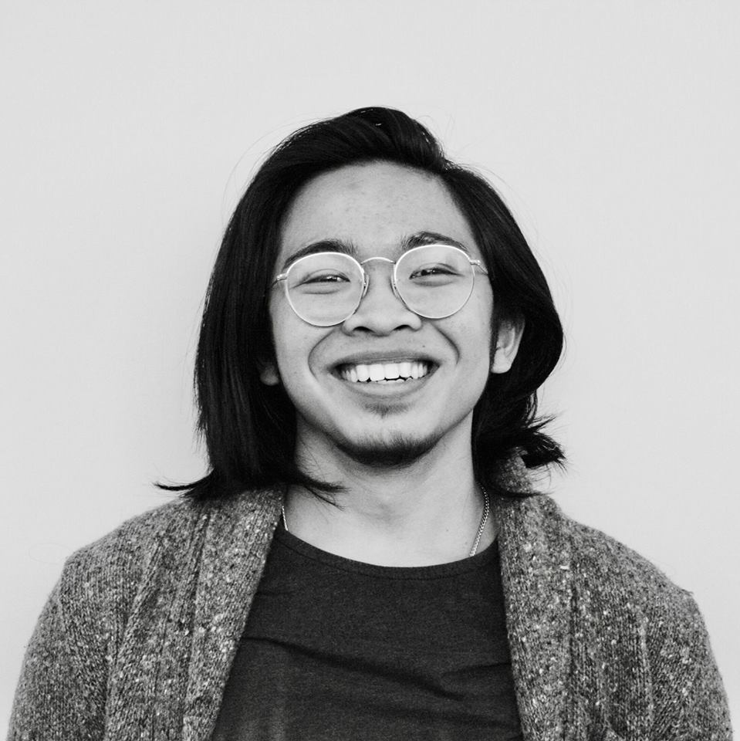
Coming Up Next in D3:
RAPS’ Battle of the Barrios
  March 24th (This Saturday!)
FLASH Dance Comp 2018
  April 8th
IFA’s Philippine Culture Night
  April 18th
Mixer w/ NYU’s IFA! (TBD)
  Laser Tag
  Museum Crawl
  Chelsea Market

Slide 15

BATTLE OF THE BARRIOS
WHEN:
March 24, 2018
WHERE:
Trayes Hall at Rutgers New Brunswick!
HOW MUCH:
$12 FOR PRESALE!
(Link in our emails!)

Slide 16

IFA’s Philippine Cultural Night!
WHEN:
Wednesday, April 18th
WHERE:
NYU’s Kimmel Center
PRICE:
$10 (tentative)
WHY THO:
Original music and writing!!
Gay representation!!
#YayaDiscourse

Slide 17
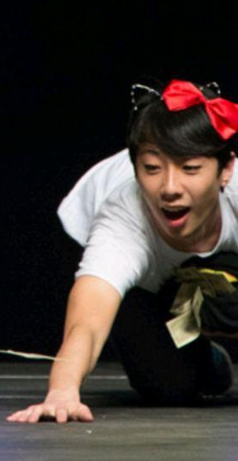
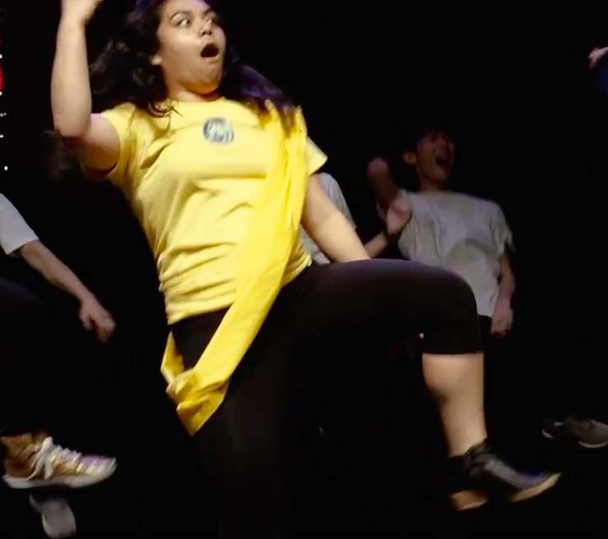
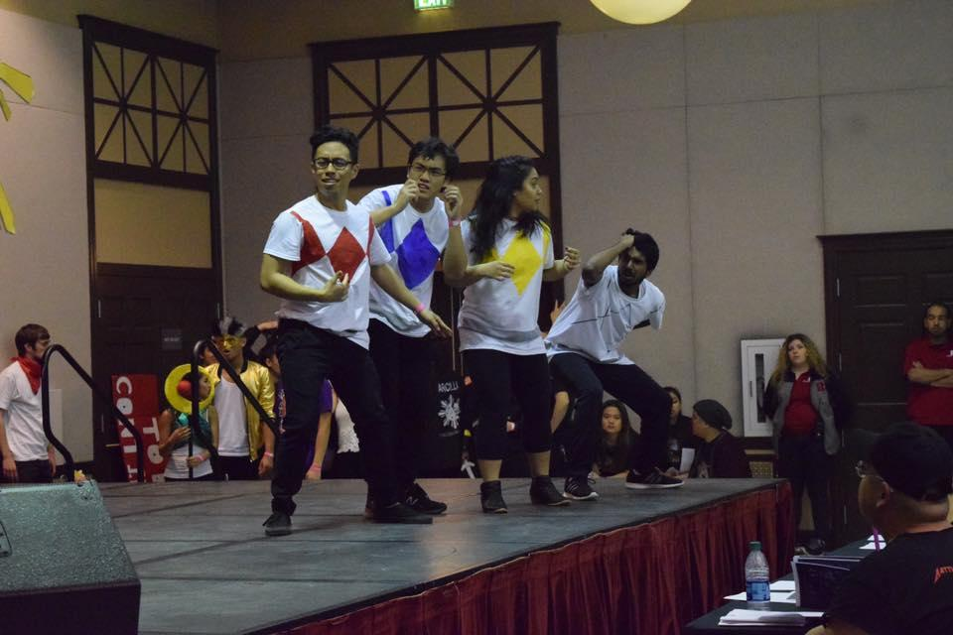
Unity 2018
There’s still time to join us for Unity! Let an E-Board member know if you’re interested!

Slide 18

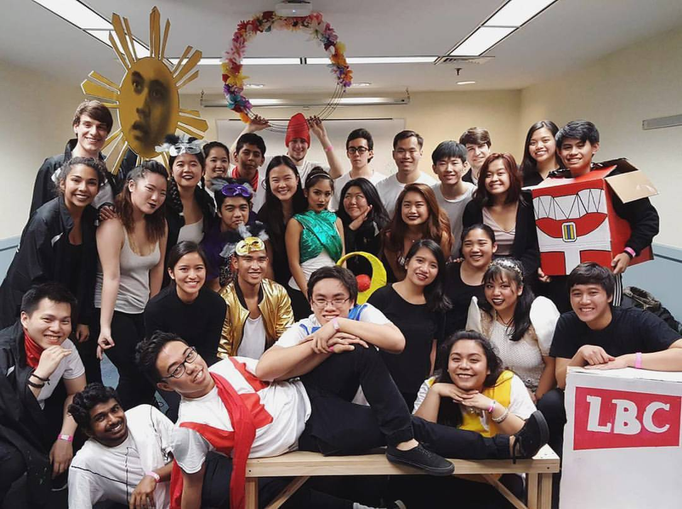
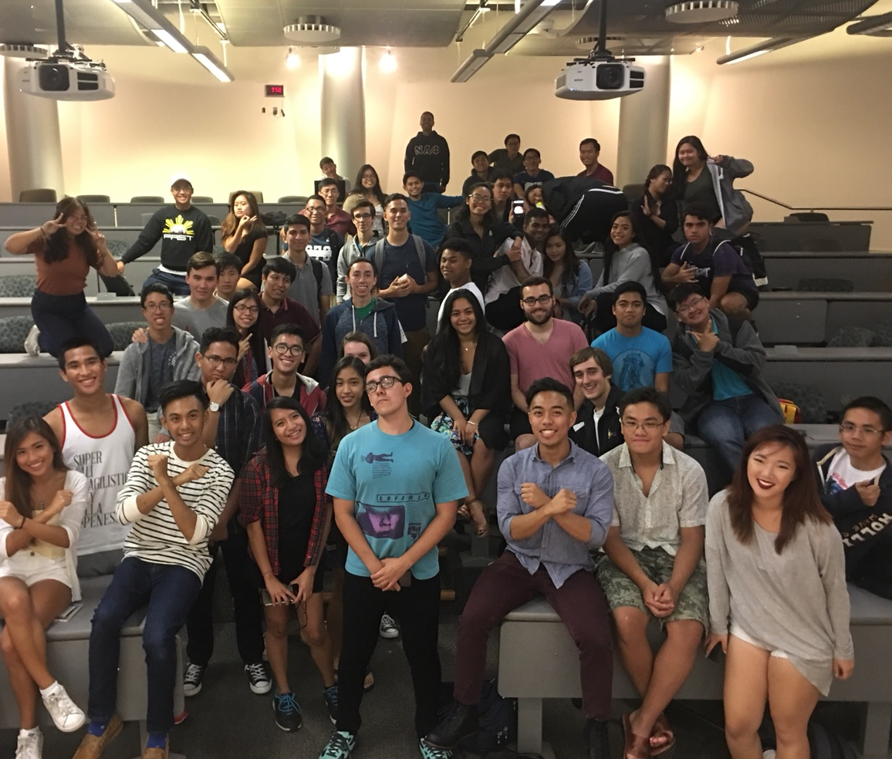
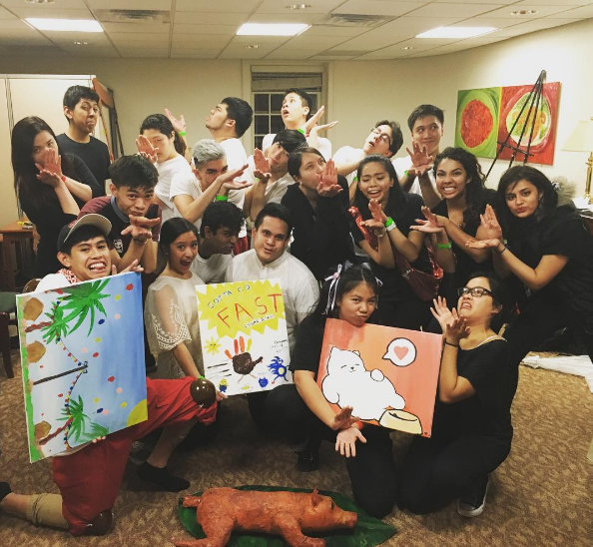
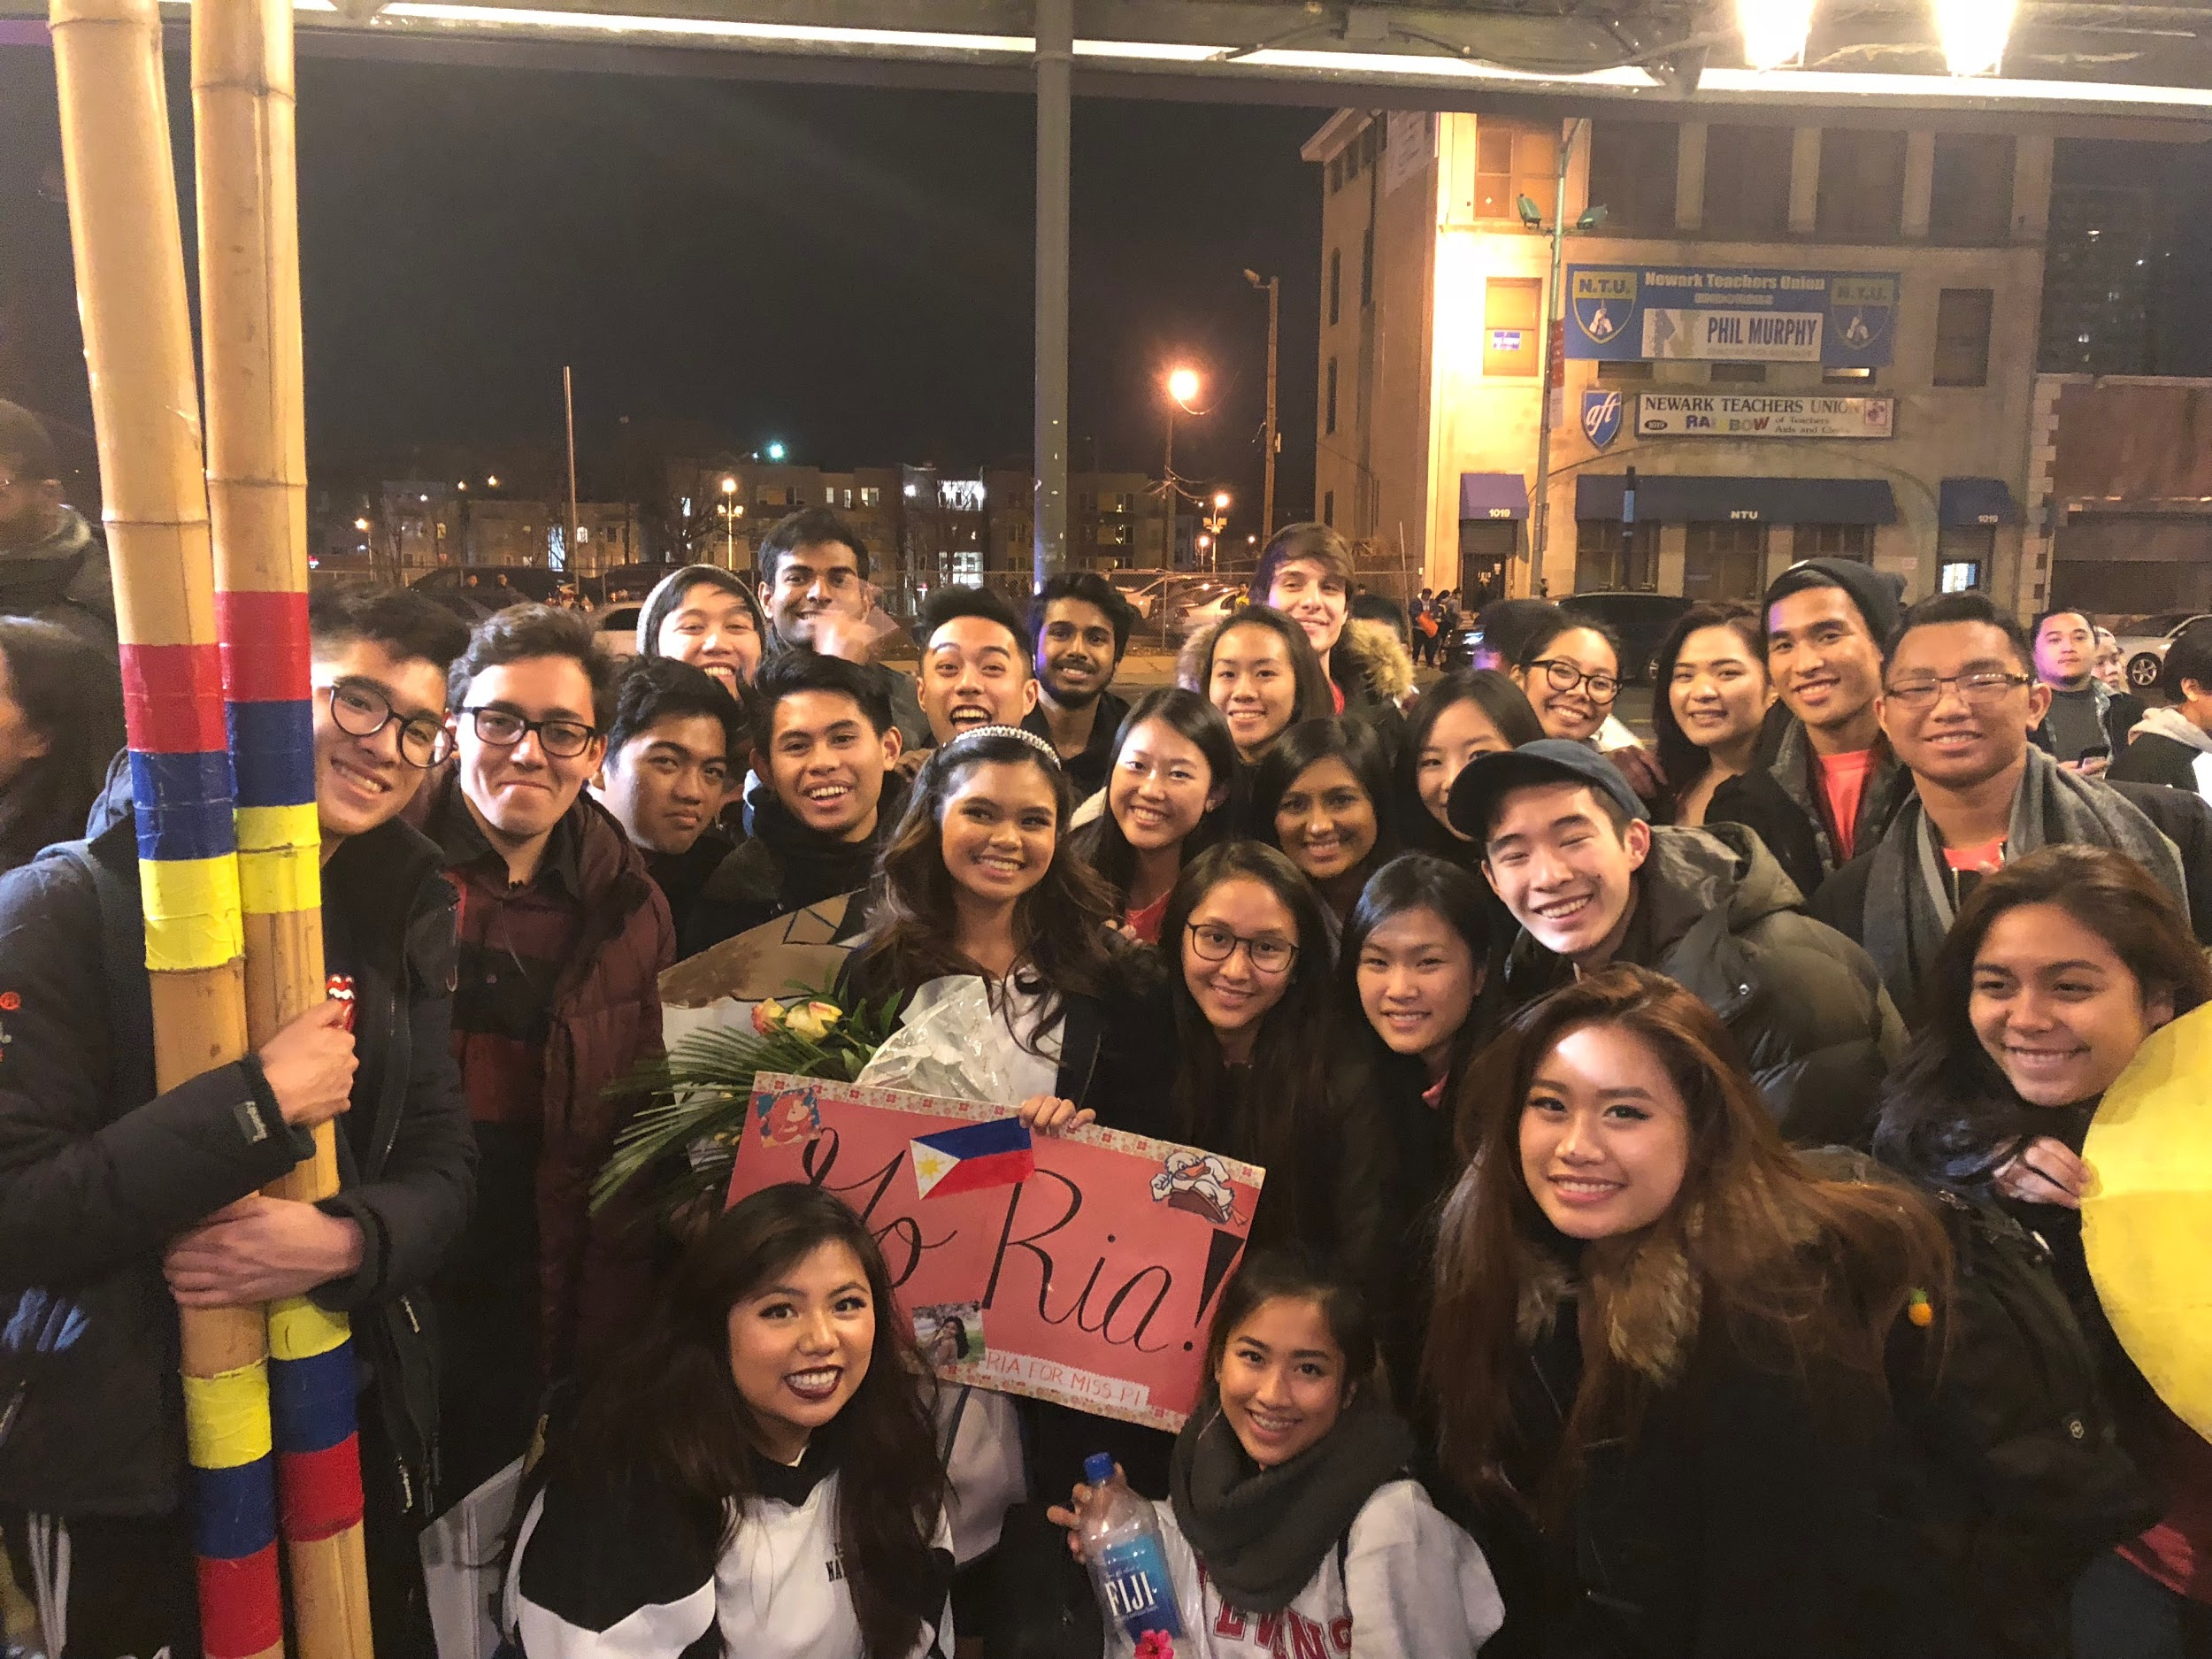

www.facebook.com/groups/StevensFAST/
www.facebook.com/StevensFAST/
@fast_family
#FASTFamily
#FASTAdventures
#FASTMemories
#FASTMemes
Contact Ellie Kim if you would like to be added to the mailing list!
Ask any E-Board member to be added to the GroupMe!
Looking for new Insta PR! LMK if you’re interested!

Slide 19

ADD US ON SNAPCHAT !!!!!!!!!!!!

Slide 20
Ay nako, it’s Elections Time!

Slide 21
Nominations
President:
James Francisco, George Jude Ibuna,
Anthony Lucero
Vice President:
James Francisco, George Jude Ibuna,
Daniella Magcalas
Treasurer:
George Jude Ibuna, Olivia Lew,
Mark Del Rosario
Secretary:
Mark Del Rosario
Social Chair:
Michael Ameer, Olivia Lew, Lorie Rosado, Ria Salvacion
Cultural Chair:
Michael Ameer, James Francisco,
Ivy Robalino, Humphrey De Guzman
ESC Representative:
Austhyn Alfaro, Michael Ameer,
Ivy Robalino
FIND Representative:
George Jude Ibuna, Lorie Rosado

