Slide 2
SWE Nationals 2012
Houston, Texas
November 8-10, 2012

Slide 3
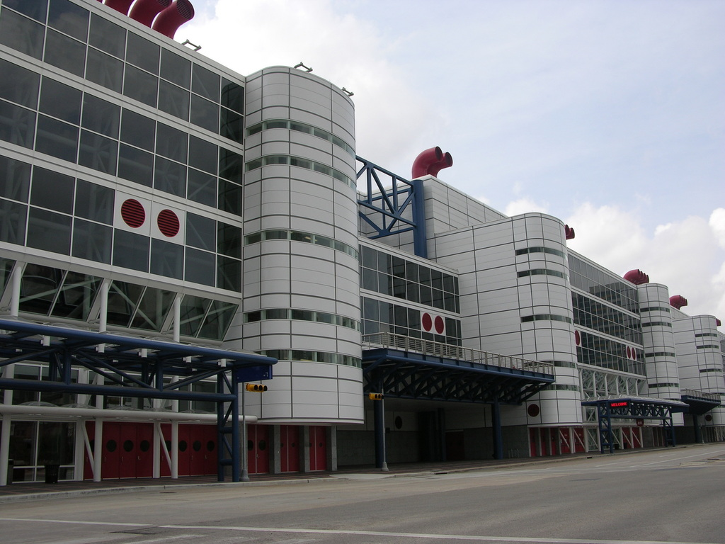
George R. Brown Convention Center

Slide 4
Workshops
Interviewing Skills
How to work a career fair
Adjusting to the workplace
Applying to graduate school
Careers with a Ph.D

Slide 5
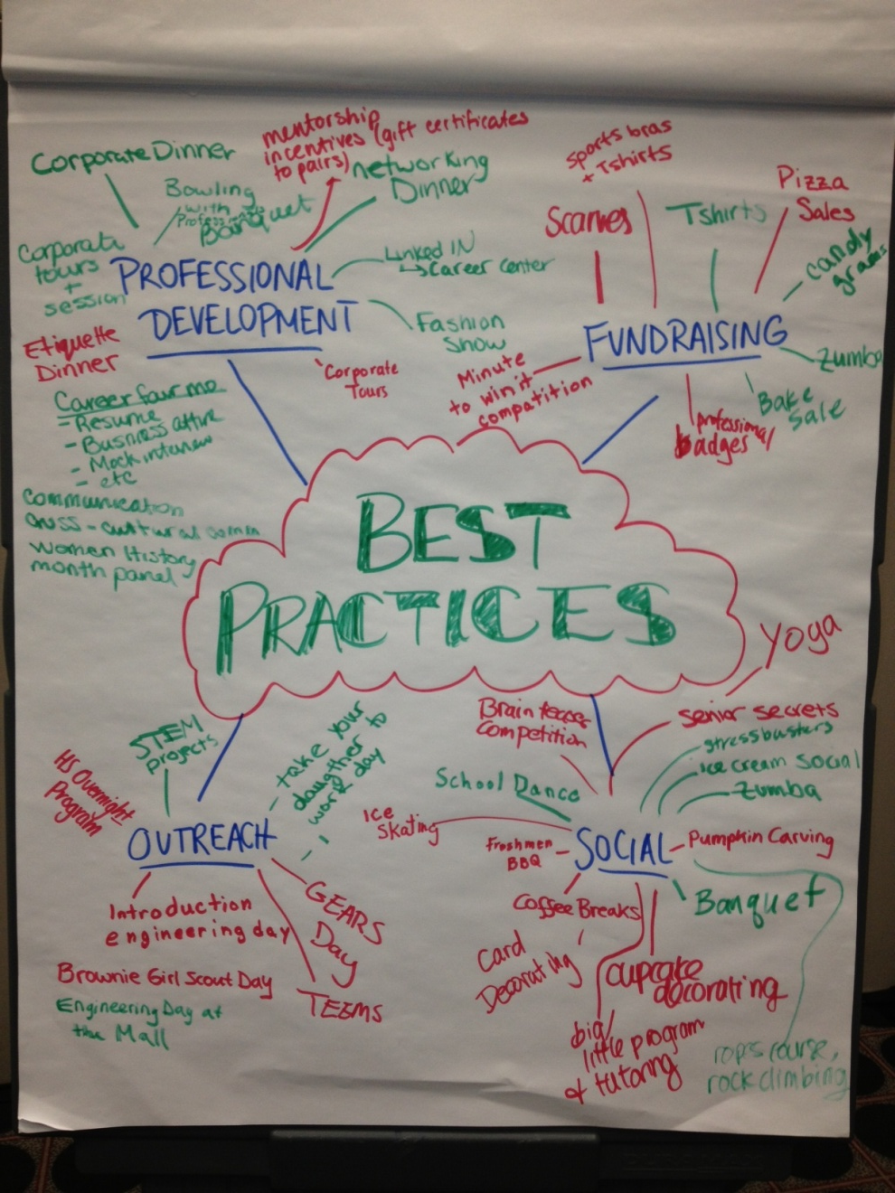
Region E Meeting
Schools – UVA, NJIT, Cornell, Rutgers, etc.
Exchange of ideas for events
Discussed organization and structure of a section

Slide 6
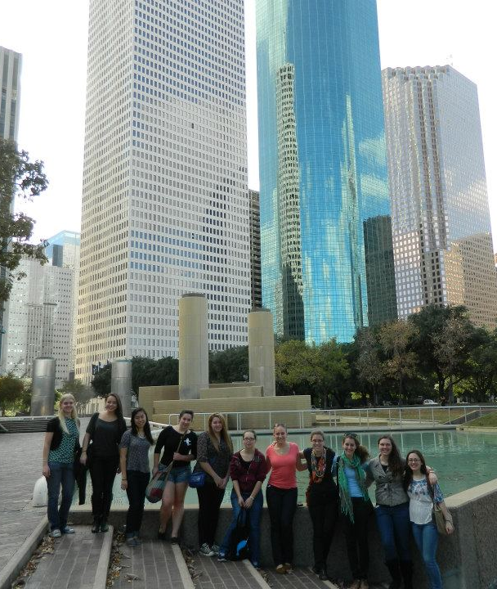
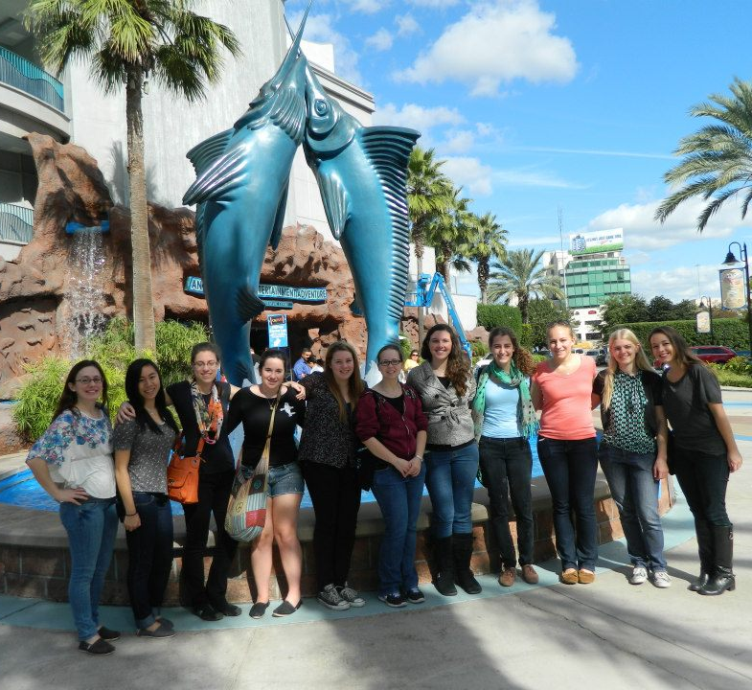
Exploring the City

Slide 7
Next Year’s Convention
Baltimore, Maryland!
October 24-26, 2013
Nice and close
Organization of the trip will be done over the summer/early fall

