Slide 1
Medical Experience Program
Stevens Health Professional Club

Slide 2
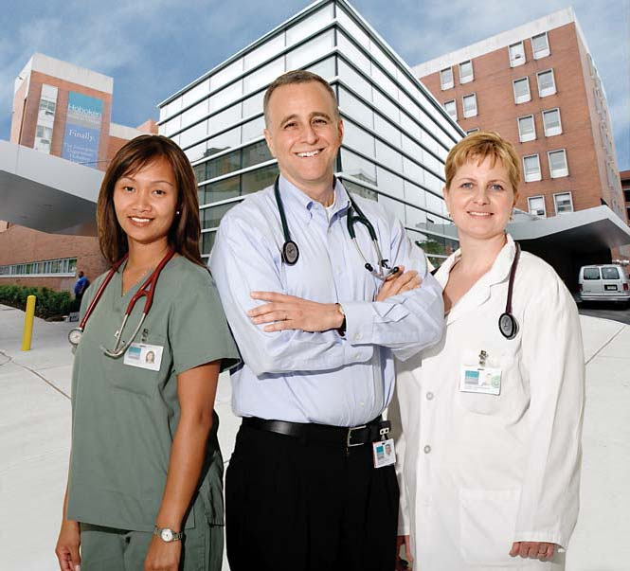
Description
Hoboken University Medical Center
2-5 qualified and committed applicants
Great clinical experience for Med School
Great for other fields as well (Med Device, PA school, nursing, etc.)

Slide 3
What We are Looking For
Students looking for Clinical Experience
Students with Good Time Management Skills
Students exhibiting Professionalism and Humanism
Proactive/Dedicated Students:
Willing to work 1 on 1 with volunteering dept, residents, OR staff to get in hours
Great prep for rotations/residency
It is what you make it!

Slide 4
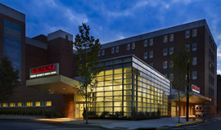
Program Requirements
Volunteering
3 hrs a week (daytime)
2 hrs a week (night time)
Can be on weekends
Surgery viewings
Mornings/weekdays only
~2hrs a week
Shadow doctors
~2hrs a week
Total: ~6 to 7 hrs a week

Slide 5
MEP Spring 2013 Semester Session
Application due 11/30 @ 9pm to MEP email
Interview Invitations between 12/3 and 12/13
There will be a 3 hour mandatory Volunteer Training Session at HUMC
Begin MEP shortly after training session and PPDs

Slide 6
Questions:
Feel Free to Contact
Eboard: SHPC.eboard@gmail.com or
Erin Duggan- erin.duggan.stevens@gmail.com
With any questions or comments

