Slide 1
Stevens Health
Professionals Club
Welcome!
2/10/14
shpc.eboard@gmail.com

Slide 2
Meet the E-Board
President: Gregory Nikogosyan
Vice President: John Bianchi
Treasurer: Tushar Patel
Secretary: Vick Zucker
Historian: Spencer Lin
SGA Representative: Sebastion Castrillon

Slide 3
What is SHPC?
Group of students who are dedicated to healthcare professions and who aspire for a healthcare career.
Those who are also interested in learning more about the various health professions and their practices.

Slide 4
What we do?
As your E-Board we are dedicated to providing educational and volunteer opportunities for students.
We aim to provide a close network among students,… we want to help you succeed!

Slide 5
What interests you?
Medicine
Dentistry
Veterinary
Physical therapy
Physician assistant
Emergency Medical Technician

Slide 6
Some of our plans
Affordable Care Act – Stevens Law/SHPC
Nominations/Election Meetings
UMDNJ, DO and PA schools
Patient Photography – Rick Guidotti
Suture Lab
Stevens Professions Panel – AED/SHPC
Medical School/Dental School process – Dr. Jones

Slide 7
Election Nominations
Nominations will open 2/24/14
You can email a nomination to shpc.eboard@gmail.com
To be nominated by someone
Must be a recognized member
Must have attended at least two general body meetings
If nominated for President and not elected, candidate can drop down to any lower position and be re-voted upon.
All nominees will be allowed a 5 minute speech to general body.
Newly elected officers will then be transitioned throughout the next couple weeks.
Election will be on 3/3/14

Slide 8
HPAC
Health Professions Advisory Committee
Consists of multiple professors across different focuses.
Think of this as a practice interview!
Helps them gauge your interest in your professional school

Slide 9
HPAC
Must have taken your respective exam (i.e. MCAT, DAT, …) – Make sure scores are accessible to Stevens.
Write a personal statement explaining why you want to go into that field.
Prepare a Curriculum Vitae (Resume)

Slide 10
HPAC
CV-Resume
Summary of what you are going to list
Education
Career History/Accomplishments
Organizations you’ve belonged to and what you accomplished
Research Experiences
Teams
Honor Societies
Jobs
Awards
Membership and Affiliations (club organization)
Medical Experiences
Get letters of recommendation sent to Professor Jones

Slide 11
HPAC
Letters of Recommendation
2 science & 1 humanities minimum requirement for Medical Schools (Make sure on letterhead)
If you are applying to a program with different requirements adjust accordingly
HPAC writes a committee letter on behalf of the school, looks not so good if you don’t get one.

Slide 12
HPAC
Deadlines
Generally you want your HPAC Interview in April so you can apply early into the cycle.
Dress well, stay on your toes, and tell the truth.
They know more than you think and have experience

Slide 13
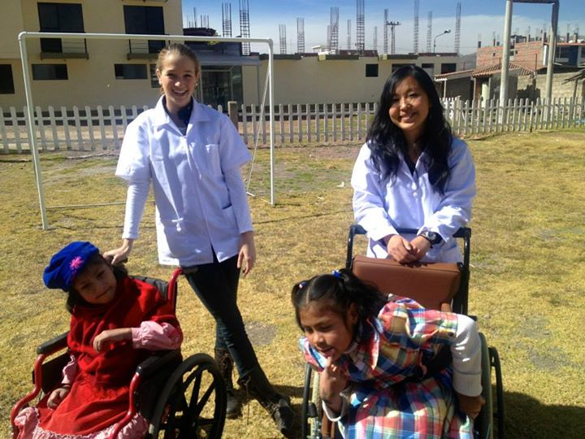
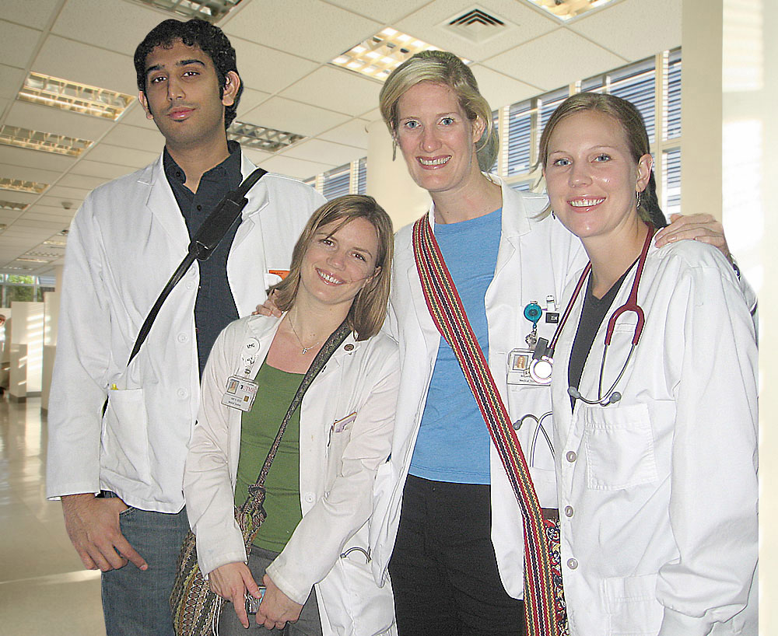
Chile/Peru Summer
Take two college Spanish courses with exposure to Latin American healthcare
Chile: May 25th to July 5th
Peru: July 6th to August 16th
Tuition $2,499

Slide 14
ATLANTIS Project
European public hospital internship
Spain and Portugal
App deadline Mar. 2, 2014
Cost w/o air fair $1260-2480
Scholarships are awarded in the amounts of $1,000 and $3,000. 10% of students receive such aid.

Slide 15
Hoboken Volunteer
If you are interested in volunteering at the hospital in Hoboken, please let us know.
If you are interested in EMT volunteering we can also help!

Slide 16
Help Us Help You
Help us make SHPC better by giving us suggestions!
If there is something you would like that isn’t covered lets work together and figure it out!
If you would like to set up event or bring a speaker as well let us know.

Slide 17
Happy Monday
Good luck with classes!

