Slide 1
Road to Medical School
Mark Liotta
mliotta@stevens.edu
29mark@gmail.com
mal429@njms.rutgers.edu
(516)-662-4623

Slide 2
Extra-Curriculars
Research (Dr. Yu)
Summer 2014 (Fr) → Spring 2015 (Soph)
Research(Dr.Leopold, Hackensack, CHI)
Summer 2015 (Soph) → Spring 2016 (Jr)
Internship (CooperSurgical, Inc.)
Summer 2016 (Jr)
Physician & PA Shadowing (64hrs)
June 2015, Aug 2015, Nov 2015 (Jr)
ER Scribe (ScribeAmerica) (370hrs)
Fall 2015 – Spring 2016 (Jr)
ER Volunteer (174 hrs)
Fall 2014 (Soph) – Dec 2015 (Jr)
JerseySTEM (Nonprofit)
2013 (Fr) – Now (Sr)
Crew (Treasurer)
Fall 2013 (Fr) – Fall 2016 (Sr)
Italian Club (Treasurer)
Fall 2013 (Fr) – Fall 2016 (Sr)
Stevens Ambassador
Spring 2014 (Fr) – Now (Sr)
Honor Board (Head of Outreach)
Fall 2015 (Jr) – Now (Sr)
Hoboken Shelter (Volunteer)
Fall 2015 (Jr) – Spring 2016 (Jr)
Scholarships/Recognitions

Slide 3
MCATS
“Fun” Stuff
What I Did
Exam Date: June 2, 2016
Prep time: 3 weeks
Prep Schedule
Take Day 1, Psych Flash Cards at Night Day 1, Review Day 2, Repeat
Materials
Kaplan Books w/Exams ~$150
Kaplan Flash Cards ~$30
AAMC Exams, NextStepMCAT - $130
Total 6 practice tests
What You Should Do
Exam Date: Ideal January
Prep time: ~6 months
Review books & Materials (Summer Prior → Winter Break)
Practice Tests (Winter Break)
Prep Schedule
Take Day 1, Review Day 2, Repeat
Flashcards Each Night
Materials
Kaplan Books w/Exams ~$150
Kaplan Flash Cards ~$30
AAMC Exams, NextStepMCAT - $130
Total 10 practice tests

Slide 4
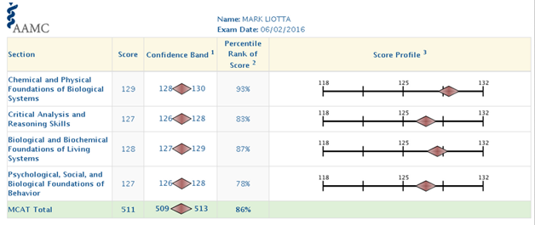
MCAT Results
MCAT: 511 (86th percentile) June 2 2016

Slide 5
HPAC & Letters of Rec
Schools will take Committee Letter or group of letters
(Generally 2 Science & 1 Humanity)
Dr. Leopold (CHI), Dr. Williams (Mech Solids & Thermo), Dr. MacPhail (GPH), Dr. John Rimmer (HUMC ER)
I would recommend one additional letter if you can
HPAC conducts interview, takes your letters, writes a combined letter of Rec
Submits “packet” with their letter and all other letters

Slide 6
Timeline
AMCAS (Primary Application)
Opens Mid/End May
Stevens Transcript Sent to AMCAS
Mid/End May
Letters of Rec, Give Code to HPAC, they send to AMCAS
Mid/End May
After Submission, Authentication Period (1-4 weeks)
Earliest Primary Sent Out
End of June
Receive Secondary from Designated Schools
End of June-July
Submit Secondaries
End of July
Interviews
August - March

Slide 7
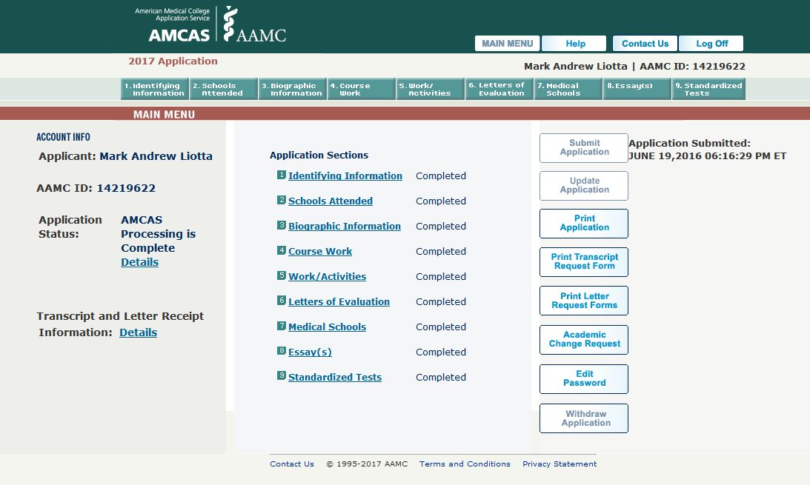
AMCAS
Standard Info
Work/Activities – Up to 15 Inputs
Need Name, Start/End Date, Hours, Location, Contact Name/Position/#, Description (700 or fewer characters), Meaningful Summary (1325 or fewer)
My Personal Statement
“Engineering Physician”

Slide 8
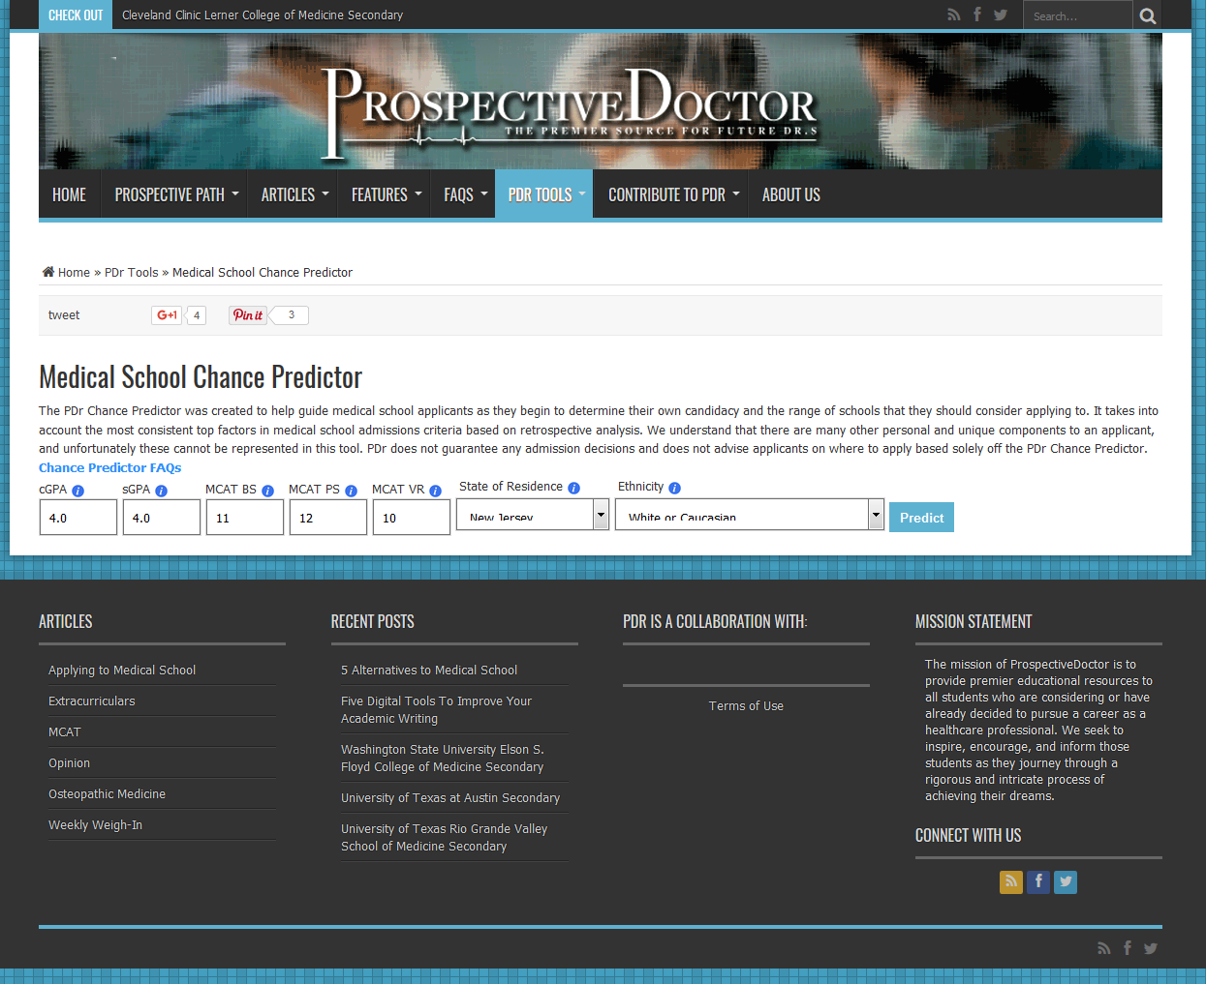
June 2016 (Summer Junior → Senior)
What Schools to Apply to?
Prospective Doctor
http://www.prospectivedoctor.com/chance-predictor/
cGPA | 4.0
sGPA | 4.0
MCAT BS | 11
MCAT PS | 12
MCAT VR | 10
State Resid | NJ
Ethnicity | White

Slide 9
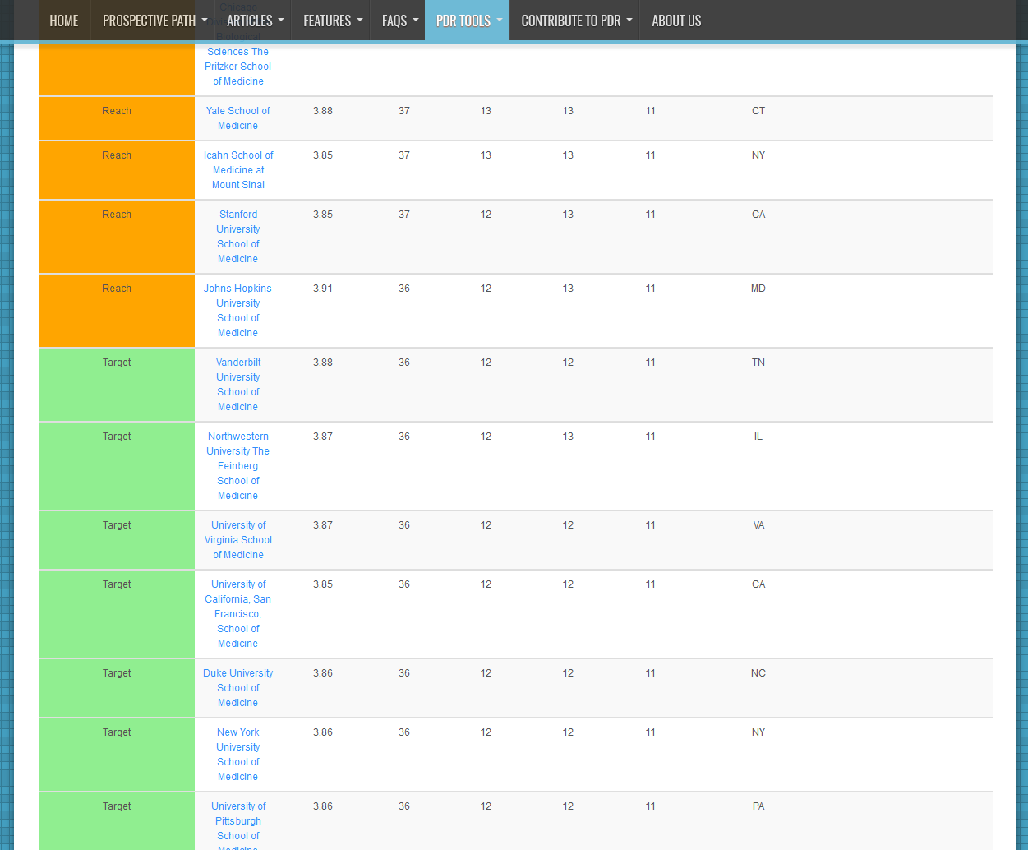
June 2016 (Summer Junior → Senior)
Chance Predictor Results

Slide 10
June 2016
Schools Applied To
Chance | Reach | Target | Undershoot | Far Undershoot
School | Icahn School of Medicine at Mt. Sinai | Boston University Dartmouth Columbia University Stony Brook University Mayo Medical School Tufts NYU Weill Cornell University of Pittsburgh University of Virginia | Georgetown Albert Einstein Brown Rutgers - NJMS Rutgers – RWJ UMass Hofstra | George Washington New York Medical College Quinnipiac Drexel Cooper Medical Albany Medical College Penn State Virginia Tech Thomas Jefferson

Slide 11
Interviews & Know Your Pitch
2-Types
Normal Interview
Multiple Mini Interviews
What’s your story?

Slide 12
June 2016
Schools Applied To
Chance | Reach | Target | Undershoot | Far Undershoot
School | Icahn School of Medicine at Mt. Sinai | Boston University Dartmouth Columbia University Stony Brook University Mayo Medical School Tufts NYU Weill Cornell University of Pittsburgh University of Virginia | Georgetown Albert Einstein Brown Rutgers - NJMS Rutgers – RWJ UMass Hofstra | George Washington New York Medical College Quinnipiac Drexel Cooper Medical Albany Medical College Penn State Virginia Tech Thomas Jefferson

Slide 13
What I Looked for in a School
Residency Placement
Location
Clinical/Early Exposure
Engineer/Innovation Focused
mliotta@stevens.edu
29mark@gmail.com
(516)-662-4623

